Slide 1

Finding patterns in deaths in Game of Thrones using Machine Learning

Slide 2
Data Set
~2000 characters
27 Features (title, gender, culture, age, nobility, presence in each book, number of dead relations, popularity etc.) *
Categorical Variable : ‘Alive’ or ‘Dead’
* https://medium.com/towards-data-science/finding-patterns-of-death-in-game-of-thrones-using-machine-learning-68cf95d7f1d1

Slide 3
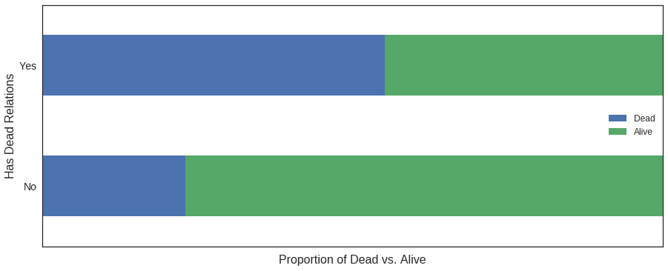
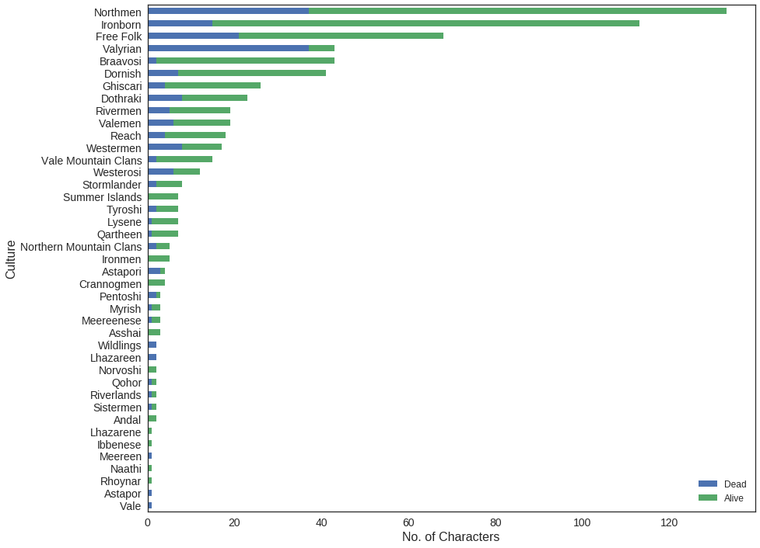
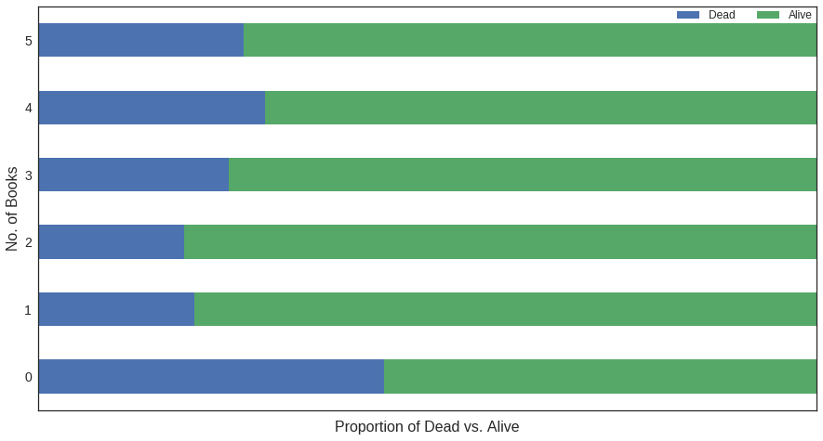
Exploratory Data Analysis

Slide 4
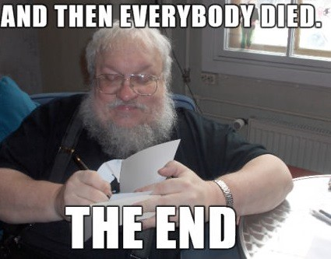

Slide 5
https://www.kaggle.com/shaildeliwala/exploratory-analysis-and-predictions
https://www.wsj.com/articles/fans-geek-out-over-game-of-thrones-data-1499877067
Another Interesting Read
https://www.theguardian.com/technology/2016/apr/19/game-of-thrones-algorithm-jon-snow-death (Spoiler Alert !!)

